Slide 1
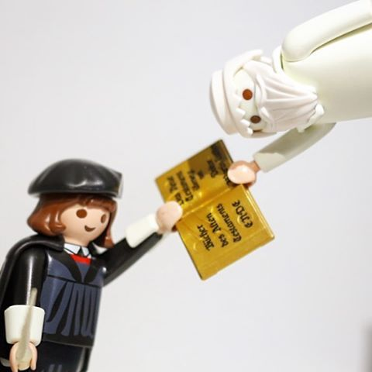
Imagineering and the Technosphere Workshop
The Embodiment of Techne:
Remarks on Martin Luther’s Open Letter on Translating
Will Hasty

Slide 2
The Ruin of Aura
“The presence of the original is the prerequisite to the concept of authenticity.”
(“The Work of Art in the Age of Mechanical Reproduction,” translated by Harry Zohn, from the 1935 essay in Illuminations edited by Hannah Arendt [New York: Schocken Books], 1969; http://web.mit.edu/ allanmc/www/benjamin.pdf; essay section II)
“Das Hier und Jetzt des Originals macht den Begriff seiner Echtheit aus.” (italics added)
(Walter Benjamin, “Das Kunstwerk im Zeitalter seiner technischen Reproduzierbarkeit,” in Walter Benjamin, Illuminationen, ausgewählte Schriften [Suhrkamp: Frankfurt a.M., 1977], 139)

Slide 3
The Ruin of Aura
“The authenticity of a thing is the essence of all that is transmissible from its beginning, ranging from its substantive duration to its testimony to the history which it has experienced. Since the historical testimony rests on the authenticity, the former, too, is jeopardized by reproduction when substantive duration ceases to matter. And what is really jeopardized when the historical testimony is affected is the authority of the object.
One might subsume the eliminated element in the term ‘aura’ and go on to say: that which withers in the age of mechanical reproduction is the aura of the work of art. This is a symptomatic process whose significance points beyond the realm of art” (II).
“Die Echtheit einer Sache ist der Inbegriff alles von Ursprung her an ihr tradierbaren, von ihrer materiellen Dauer bis zu ihrer geschichtlichen Zeugenschaft. Da die letztere auf der ersteren fundiert ist, so gerät in der Reproduktion, wo die erstere dem Menschen entzogen hat, auch die letztere: die geschichtliche Zeugenkraft der Sache ins Wanken. Freilich nur diese: was aber dergestalt ins Wanken gerät, das ist die Autorität der Sache.
Man kann, was hier ausfällt, im Begriff der Aura zusammenfassen und sagen: was im Zeitalter der technischen Reproduzierbarkeit verkümmert, das ist seine Aura” (140-141).

Slide 4
The Shattering of Tradition/The Renewal of Mankind Die Erschüttering der Tradition/Die Erneuerung der Menschheit
The contemporary decay of aura rests on: “the desire of contemporary masses to bring things ‘closer’ spatially and humanly, which is just as ardent as their bent toward overcoming the uniqueness of every reality by accepting its reproduction” (III).
[…]: “Die Dinge sich räumlich und menschlich ‘näherzubringen’ ist ein genau so leidenschaftliches Anliegen der gegenwärtigen Massen wie es ihre Tendenz einer Überwindung des Einmaligen jeder Gegebenheit durch die Aufnahme von deren Reproduktion ist”(142).

Slide 5
The Shattering of Tradition/The Renewal of Mankind Die Erschüttering der Tradition/Die Erneuerung der Menschheit
“But the instant the criterion of authenticity ceases to be applicable to artistic production, the total function of art is reversed. Instead of being based on ritual, it begins to be based on another practice—politics” (IV).
“In dem Augenblick aber, da der Maßstab der Echtheit an der Kunstproduktion versagt, hat sich auch die gesamte soziale Funktion der Kunst umgewälzt. An die Stelle Ihrer Fundierung aufs Ritual tritt ihre Fundierung auf eine andere Praxis: nämlich ihre Fundierung auf Politik”(145).

Slide 6
The Shattering of Tradition/The Renewal of Mankind Die Erschüttering der Tradition/Die Erneuerung der Menschheit
“The whole sphere of authenticity is outside technical—and, of course, not only technical—reproducibility” (II).
“Der gesamte Bereich der Echtheit entzieht sich der technischen– und natürlich nicht nur der technischen – Reproduzierbarkeit” (139).
What really happens with “authenticity”/“authority” – the here(s) and now(s) of [the] original(s)-- in the transition from cultic to political domains posited by Benjamin during the “Age of Mechanical Reproduction”? What (kind of) “authority” really legitimizes (i.e. “authorizes”) politics? Might there be a political-artistic kind authority consistent with the “Renewal of Mankind” and thus fundamentally other than the kind of authenticity/authority associated with cultic, “tribal” practices?

Slide 7
Getting a Grip on different Heres and Nows: The Embodiment of Techne?
Is it possible to think about “authentic”/“authoritative” heres and nows as within technical reproducibility?
Might such authentic/authoritative heres and nows within technical reproducibility (= technosphere) – at least the part of this pertaining to crucial occidental employments of languages and literatures (i.e. textual “artworks”) – be described or circumscribed in terms of an always-ongoing madeness/making of things?
Might the descriptive/circumscriptive terms always-ongoing madeness/making of things be made somewhat more precise binarily or “digitally” as relations of eternal and immediate, infinite and infinitesimal? (-- as would need to happen to accommodate different, even opposing or mutually exclusive authoritative/authentic heres and nows?)

Slide 8
The Embodiment of Techne?
Precision Grip/
“Throwing Grip”
Pressure Grip/
“Clubbing Grip”
From “Evolution of the Human Hand: The Role of Throwing and Clubbing,” Richard W. Young https://www.ncbi.nlm.nih. gov/pmc/articles/PMC1571064/

Slide 9
The Embodiment of Techne?

Slide 10
The Embodiment of Techne?
LINK

Slide 11
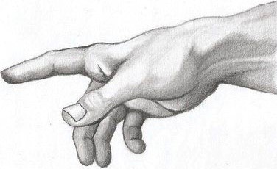
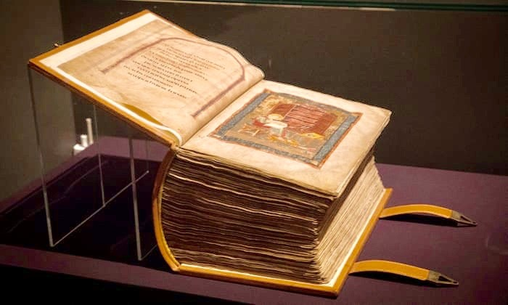
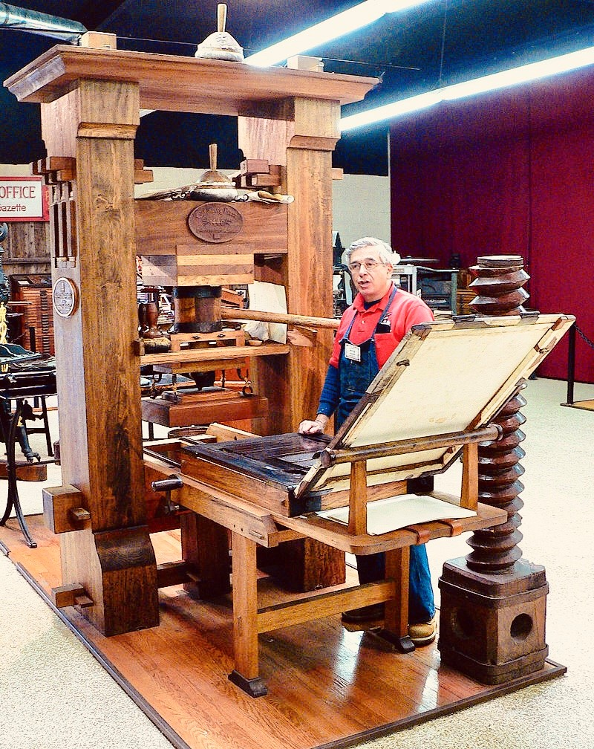
The Here and Now of Ritual Sacrifice The Here and Now of the Law The Here and Now of the Word The Here and Now of the “Spirit”

Slide 12
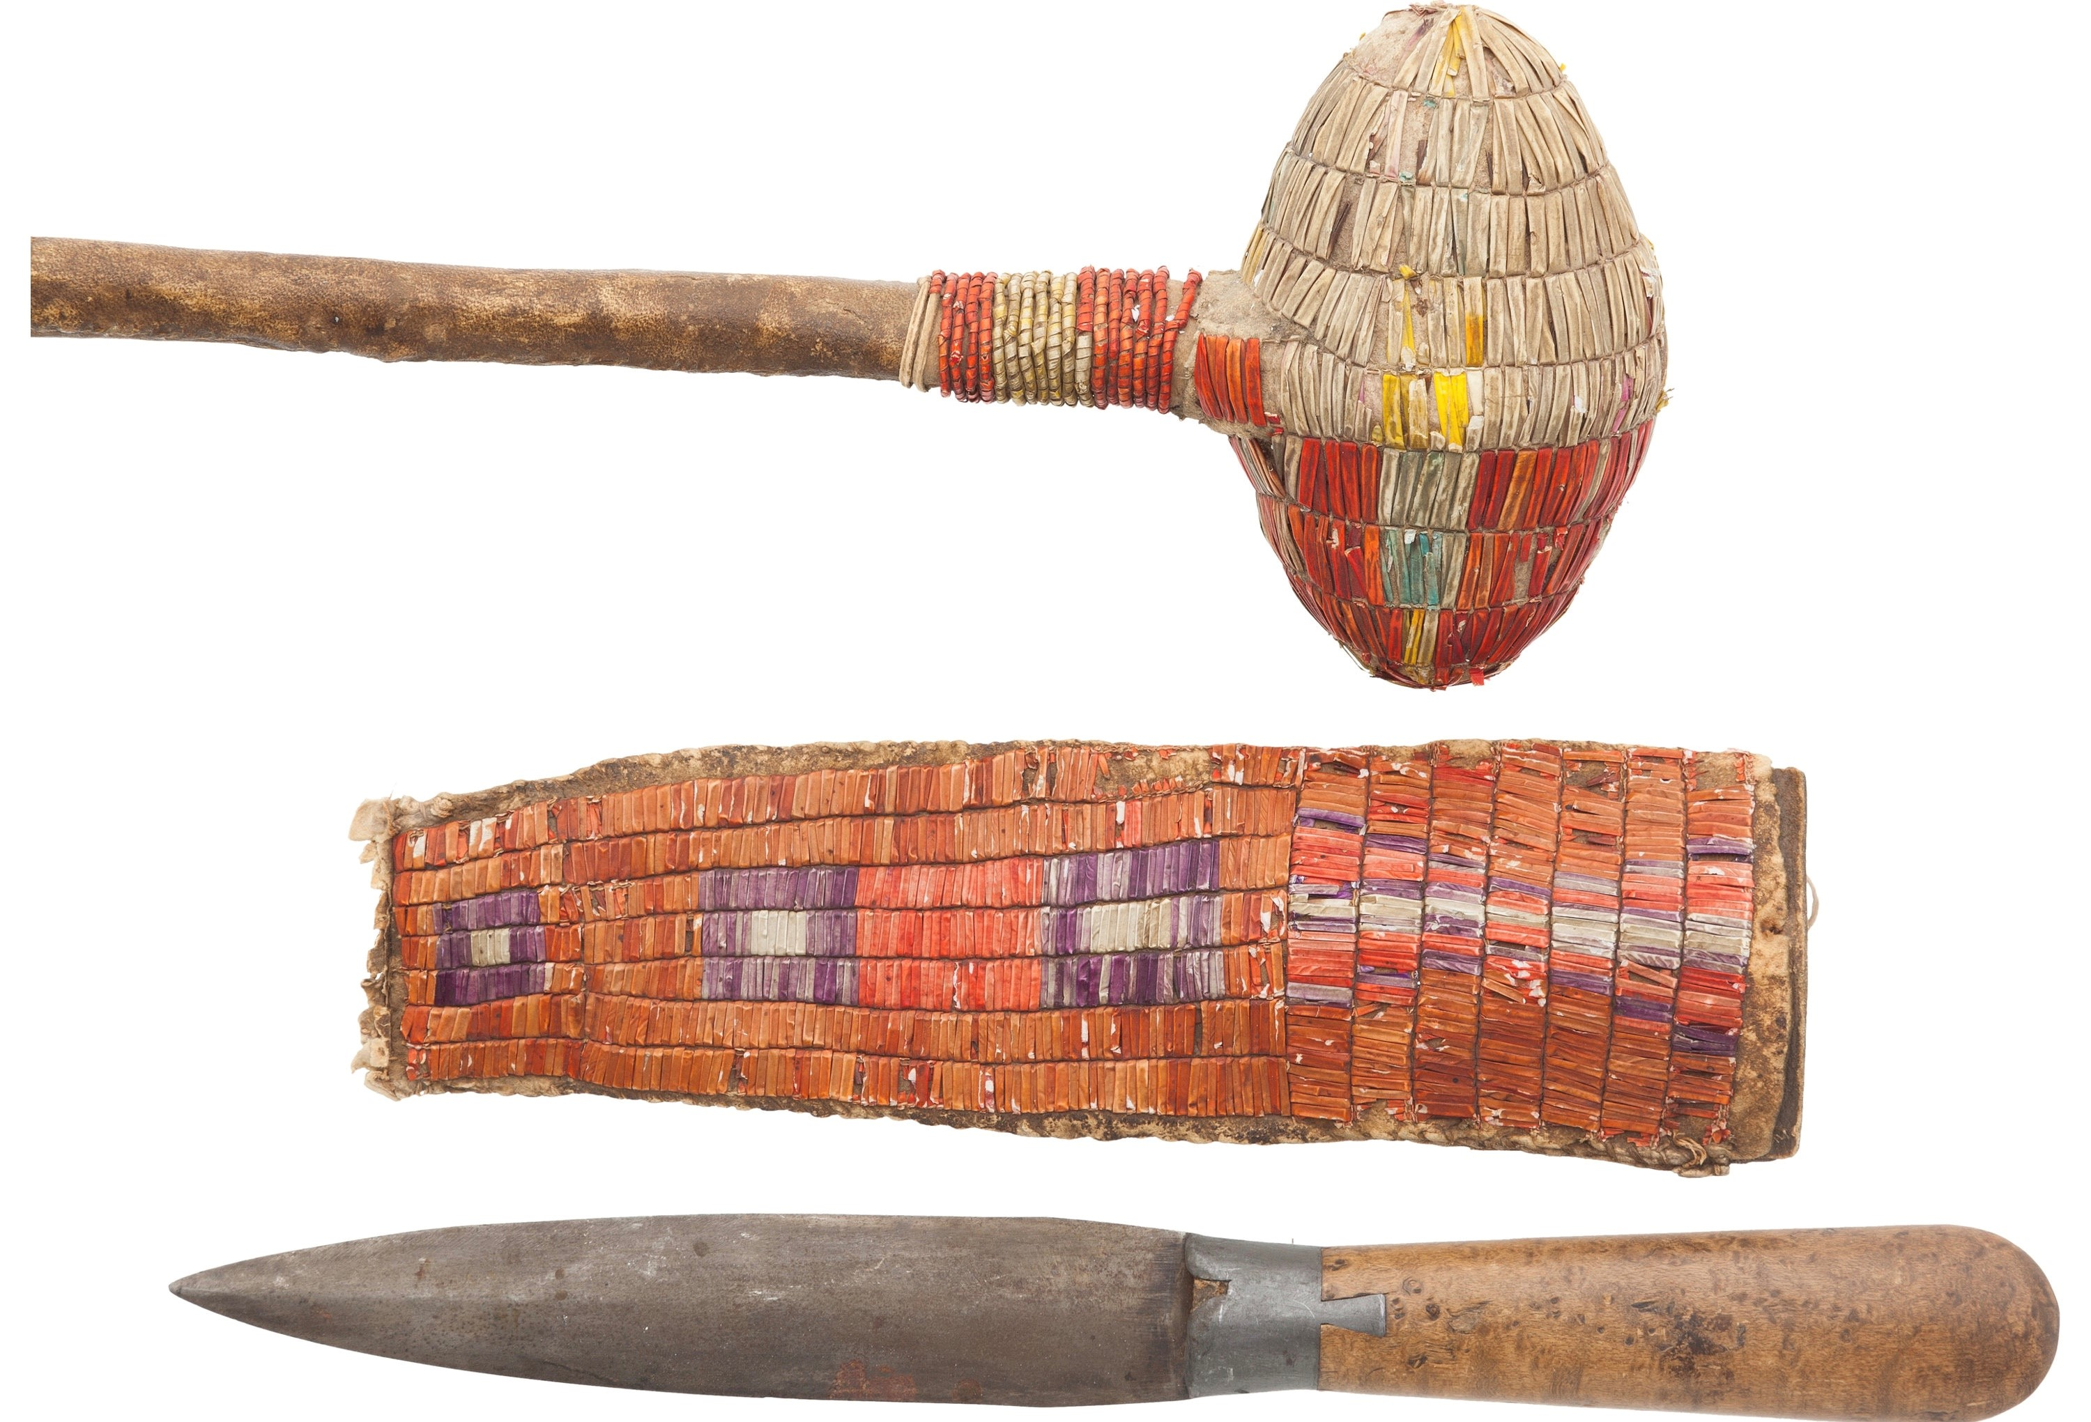
The Here and Now of Sacrificial Practices #1
“It did not take long for people to realize they could “make deals” with Nature. However volatile, violent, or vengeful they might appear to be, the gods and spirits could be pre-empted. By offering sacrifices on the “in case” principle, it was possible to tap into the most overwhelming power in the world. In this guise, sacrifices could serve as means of winning divine favor for specific as well as survival purposes– to ensure a good hunt or good harvest, to grant fertility of success in war, to ensure protection for the family or community, to preserve good health and strength and generally acquire what was most meaningful and necessary in life.”
(Brenda Lewis, Ritual Sacrifice: An Illustrated History, 3.)

Slide 13
The Here and Now of Sacrificial Practices #2
“Burnt offerings were, for obvious reasons, considered more suitable for celestial gods, but in ancient Greece they were not thought appropriate for sacrifices to vegetation and fertility gods like Dionysius or Demeter (…) In ancient Greece, sacrifices intended for the gods of the underworld were buried, though they were sometimes burned either there or in a trench dug in the earth. Sacrifices to the water gods were similarly direct: humans or animals intended as offerings were drowned in lakes or rivers, and among the Norse Vikings of Scandinavia, they were thrown over cliffs
to land in wells or waterfalls”
(Brenda Lewis, Ritual Sacrifice: An Illustrated History, 8.)

Slide 14
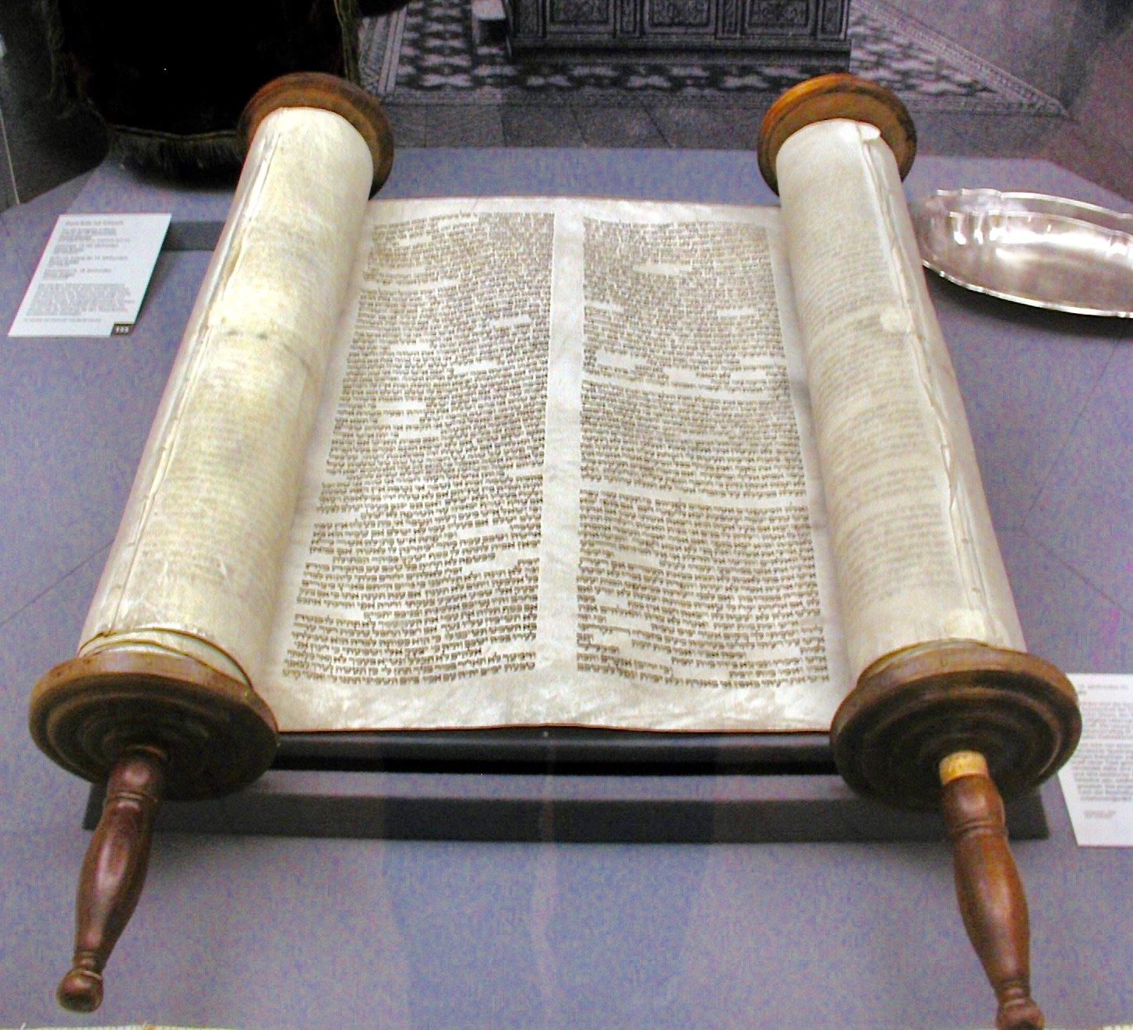
The Here and Now of the Law
Genesis Chapter 1 בְּרֵאשִׁית
א בְּרֵאשִׁית, בָּרָא אֱלֹהִים, אֵת הַשָּׁמַיִם, וְאֵת הָאָרֶץ.
1 In the beginning God created the heaven and the earth.
ב וְהָאָרֶץ, הָיְתָה תֹהוּ וָבֹהוּ, וְחֹשֶׁךְ, עַל-פְּנֵי תְהוֹם; וְרוּחַ אֱלֹהִים, מְרַחֶפֶת עַל-פְּנֵי הַמָּיִם.
2 Now the earth was unformed and void, and darkness was upon the face of the deep; and the spirit of God hovered over the face of the waters.
ג וַיֹּאמֶר אֱלֹהִים, יְהִי אוֹר; וַיְהִי-אוֹר.
3 And God said: 'Let there be light.' And there was light.
ד וַיַּרְא אֱלֹהִים אֶת-הָאוֹר, כִּי-טוֹב; וַיַּבְדֵּל אֱלֹהִים, בֵּין הָאוֹר וּבֵין הַחֹשֶׁךְ.
4 And God saw the light, that it was good; and God divided the light from the darkness.
ה וַיִּקְרָא אֱלֹהִים לָאוֹר יוֹם, וְלַחֹשֶׁךְ קָרָא לָיְלָה; וַיְהִי-עֶרֶב וַיְהִי-בֹקֶר, יוֹם אֶחָד. {פ}
5 And God called the light Day, and the darkness He called Night.
And there was evening and there was morning, one day.

Slide 15
The Here and Now of the Word
in principio erat Verbum et Verbum erat apud Deum et Deus erat Verbum
hoc erat in principio apud Deum
omnia per ipsum facta sunt et sine ipso factum est nihil quod factum est
in ipso vita erat et vita erat lux hominum
et lux in tenebris lucet
et tenebrae eam non conprehenderunt
The Gospel of John:
In the beginning was the Word: and the Word was with God: and the Word was God.
The same was in the beginning with God.
All things were made by him: and without him was made nothing that was made.
In him was life: and the life was the light of men.
And the light shineth in darkness: and the darkness did not comprehend it.

Slide 16
The Here and Now of the “Spirit”
“[Y]ou might say that I have conscientiously translated the New Testament into German to the best of my ability, and that I have not compelled anyone to read it. Rather I have left that open, only doing the work as a service to those who could not do it better. No one is forbidden to do it better! If someone does not wish to read it, he can let it lie, for I do not ask anyone to read it or praise anyone who does so. It is my Testament and my translation, and it shall remain mine.” (italics added)
“Ir mügt sagen / das ich das Newe Testament verdeudscht habe / auff mein bestes vermögen und auff mein gewissen / habe damit niemand gezwungen / das er es lese / sondern frey gelassen / Und allein zu dienst gethan / denen / die es nicht besser machen können / Ist niemand verboten ein bessers zu machen / Wers nicht lesen will / der
lasse es ligen / Ich bitte und feyer niemand drümb / Es ist mein Testament und
mein dolmetschung / und sol mein bleiben und sein.“
Martin Luther, “Open Letter on Translating,”1530; translated by Michael D. Marlowe from "Ein sendbrief
D. M. Luthers. Von Dolmetzschen und Fürbit der heiligenn" in Dr. Martin Luthers Werke, (Weimar:
Hermann Boehlaus Nachfolger, 1909), Band 30, Teil II, pp. 632-646 in June 2003: http://www.bible-researcher.com/luther01.html

Slide 17
The Here and Now of the “Spirit”
“I know very well that in Romans 3 the word solum is not in the Greek or Latin text — the papists did not have to teach me that. It is fact that the letters s-o-l-a are not there. And these blockheads stare at them like cows at a new gate, while at the same time they do not recognize that it conveys the sense of the text -- if the translation is to be clear and vigorous, it belongs there. I wanted to speak German, not Latin or Greek, since it was German I had set about to speak in the translation.”
“Also habe ich hie Roma. 3. fast wol gewust / das im Lateinischen und Griechischen Text / das wort (Solum) nicht stehet / und hetten mich solchs die Papisten nicht dürffen leren. War ists / Diese vier buchstaben Sola stehen nicht drinnen
/ welche buchstaben die Eselsköpff ansehen / wie die kue ein new thor /
Sehen aber nicht / das gleichwol die meinung des Texts inn sich hat /
und wo mans wil klar und gewaltiglich verdeudschen / so gehöret es
hinein / den ich habe Deudsch / nicht Lateinisch noch Griechisch reden
wöllen / da ich deudsch zu reden im dolmetschen furgenomen hatte.”

Slide 18
The Here and Now of the “Spirit”
(…) “We do not have to ask the literal Latin how we are to speak German, as these donkeys do. Rather we must ask the mother in the home, the children on the street, the common man in the marketplace. We must be guided by their language, by the way they speak, and do our translating accordingly. Then they will understand it and recognize that we are speaking German to them.”
(...)“man mus nicht die buchstaben inn der Lateinischen sprachen fragen / wie man sol Deudsch reden / wie diese Esel thun / Sondern man mus die mutter ihm hause / die kinder auff der gassen / den gemeinen man auff dem marckt drümb
fragen / und den selbigen auff das maulsehen / wie sie reden / und darnach dolmetschen / so verstehen sie es denn / und mercken / das man Deudsch
mit ihn redet.“

Slide 19
The Here and Now of the “Spirit”
“The reader can now run his eyes over three or four pages without stumbling once, never knowing what rocks and clods had once lain where he now travels as over a smoothly-planed board. We had to sweat and toil there before we got those boulders and clods out of the way, so that one could go along so nicely.”
“Leufft einer itzt mit den Augen durch drey odder vier bletter / und stösst nicht ein mal an / wird aber nicht gewar / welche wacken und klötze da gelegen sind / da er itzt uber hin gehet / wie uber ein gehoffelt bret /
da wir haben müst schwitzen und uns engsten / ehe denn wir solche
wacken und klötze aus dem wege reumeten/auf das man kündte so
fein daher gehen.”

Slide 20
The Embodiment of Techne. For continuing Consideration:
--“authentic”/“authoritative” heres and nows as within technical reproducibility…
--authentic/authoritative heres and nows within technical reproducibility (= technosphere) and describable or circumscribable in terms of an always-ongoing madeness/making of things…
-- an always-ongoing madeness/making of things made more precise binarily or “digitally” as relations of eternal and immediate, infinite and infinitesimal, in order to accommodate different, even opposing or mutually exclusive authoritative/authentic heres and nows?...

Slide 21
Sequential References to Images and Texts by PowerPoint Slide
Slide 1:
Luther/God/Bible image: https://www.google.com/search?rlz=1C1EJFA_enUS772US774&biw=2049&bih=937&tbm=isch&sa=1&ei=B36uXM7qGM6UtQW6g6z4Bw&q=luther+bible+translation&oq=luther+bible+&gs_l=img.1.0.0l2j0i30j0i5i30l3j0i8i30l4.228346.234707..237340...0.0..0.175.2613.23j5......1....1..gws-wiz-img.......0i24.KLdkL-e8hVA#imgrc=zjOXyCvVSjQ5GM:
Slide 2:
“The Work of Art in the Age of Mechanical Reproduction,” translated by Harry Zohn, from the 1935 essay in Illuminations edited by Hannah Arendt (New York: Schocken Books), 1969: http://web.mit.edu/allanmc/www/benjamin.pdf; essay section numbers in which passages are located are henceforth indicated on the PPT slides.
Walter Benjamin, “Das Kunstwerk im Zeitalter seiner technischen Reproduzierbarkeit,” in Walter Benjamin, Illuminationen, ausgewählte Schriften [Suhrkamp: Frankfurt a.M., 1977], 136-169; here 139); page numbers henceforth indicated on the PPT slides.
Slide 8:
Image from From “Evolution of the Human Hand: The Role of Throwing and Clubbing,” Richard W. Young https://www.ncbi.nlm.nih. gov/pmc/articles/PMC1571064/

Slide 22
Sequential References to Images and Texts by PowerPoint Slide
Slide 9:
Image Detail from Michelangelo, Sistine Chapel, Creation: https://www.google.com/search?q=sistine+chapel+ceiling+creation&source=lnms&tbm=isch&sa=X&ved=0ahUKEwi7uu7a1cXhAhWj44MKHRlaD1YQ_AUIDigB&biw=1821&bih=868#imgrc=xTL83ogjSt76EM:
Slide 10:
Robotic hand:
https://www.nytimes.com/interactive/2018/07/30/technology/robot-hands.html
Slide 11:
Club/knife: Sacrifice pichttps://juicyecumenism.com/2016/09/14/christendom-human-sacrifice/
https://historical.ha.com/itm/american-indian-art/pipes-tools-and-weapons/plains-quilled-stone-headed-club-and-knife-in-a-quilled-sheath-circa-nineteenth-century-total-3-items-/a/6101-44200.s
Sefer Torah image (detail): https://www.google.com/search?q=sefer+torah&rlz=1C1EJFA_enUS772US774&source=lnms&tbm=isch&sa=X&ved=0ahUKEwi3-qaT2cXhAhWRmOAKHbm9CsgQ_AUIDygC&biw=2049&bih=937&dpr=0.67#imgrc=-IRalh6x7-hSSM:

Slide 23
Sequential References to Images and Texts by PowerPoint Slide
Slide 11 (continued):
Vulgate Bible (Codex Amiatinus) image (detail): https://www.google.com/search?q=codex+amiatinus&rlz=1C1EJFA_enUS772US774&source=lnms&tbm=isch&sa=X&ved=0ahUKEwiJipPO2MXhAhUOVN8KHe0TD4sQ_AUIDigB&biw=966&bih=922#imgrc=gSiMfI2JNe20MM:
Printing Press image (detail): https://commons.wikimedia.org/w/index.php?curid=16412858
Slide 12:
Brenda Lewis, Ritual Sacrifice: An Illustrated History, Sutton: Gloucestershire, 2001.
Slide 14:
Genesis Hebrew/English: https://www.mechon-mamre.org/p/pt/pt0101.htm
Slide 15:
The Latin Vulgate (Codex Amiatinus):
http://www.latinvulgate.com/lv/verse.aspx?t=0&b=1
Slide 16:
Martin Luther, “Open Letter on Translating,”1530; translated by Michael D. Marlowe from "Ein sendbrief
D. M. Luthers. Von Dolmetzschen und Fürbit der heiligenn" in Dr. Martin Luthers Werke, (Weimar:
Hermann Boehlaus Nachfolger, 1909), Band 30, Teil II, pp. 632-646 in June 2003: http://www.bible-researcher.com/luther01.html

Slide 24
Sequential References to Images and Texts by PowerPoint Slide
Slide 24:
Ian F. McNeely, with Lisa Wolverton, Reinventing Knowledge. From Alexandria to the Internet (New York: Norton, 2008).
Slide 25:
Stephan Füssel, Gutenberg and the Impact of Printing, Trans. Douglas Martin (Ashgate: Burlington, Vermont, 2003).

Slide 25
Epilogue: Manuscript as Codex Word (Vulgata)
“Outside Christian contexts, the codex was nothing more than a handy notepad, chiefly reserve for administrative note-taking. Only the Christians favored these utilitarian notebooks for convenient, on-the-spot access to the contents of their guiding texts”(Ian F. McNeely, with Lisa Wolverton, Reinventing Knowledge. From Alexandria to the Internet (New York: Norton, 2008), 46)

Slide 26
Epilogue: Manuscript as Codex Word (Vulgata)
Stephan Füssel writes: “Gutenberg’s invention is as simple as it is ingenious: texts were broken down into their smallest components, i.e. into the 26 letters of the Roman alphabet, and from placing single letters in the right order the new text would result time and time again. Texts had been copied over the centuries by writing them completely and sequentially, or by cutting them equally completely in wood (…), but now only the letters of the alphabet had to be cut and supplies cast and they would always be available for setting up whatever text was chosen” (Gutenberg and the Impact of Printing, 15).

